Slide 1

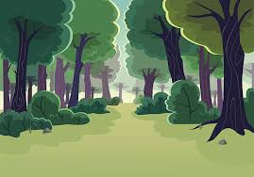
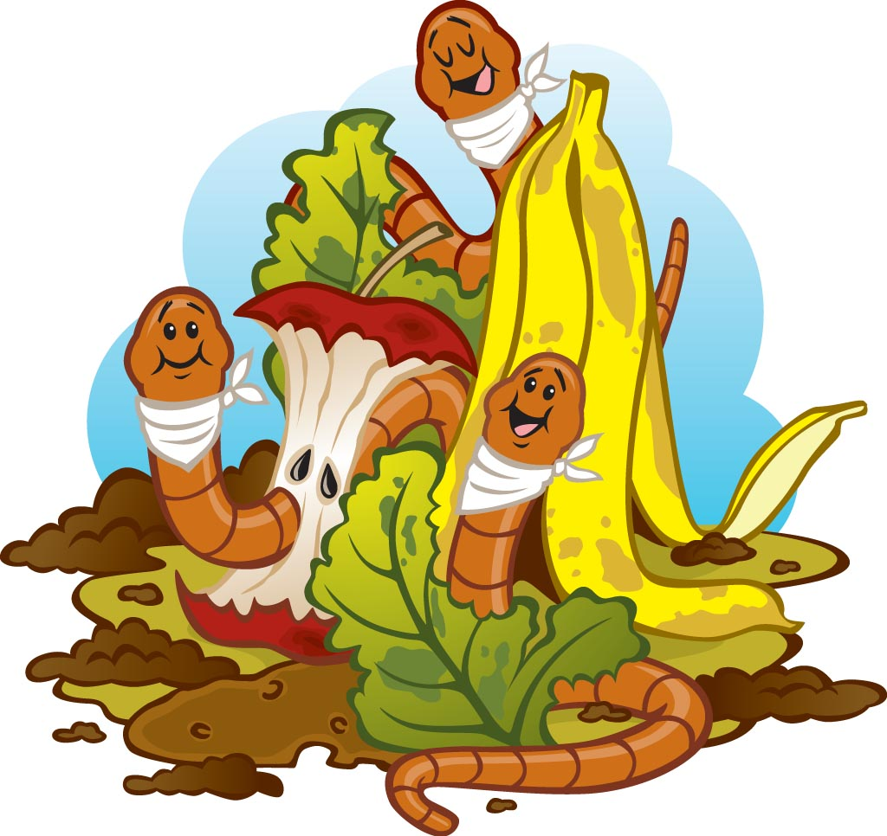

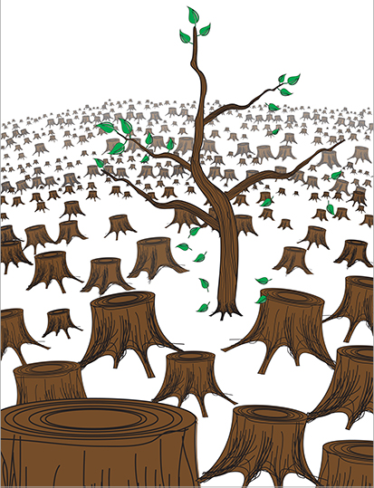


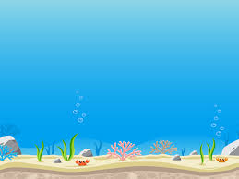
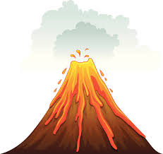
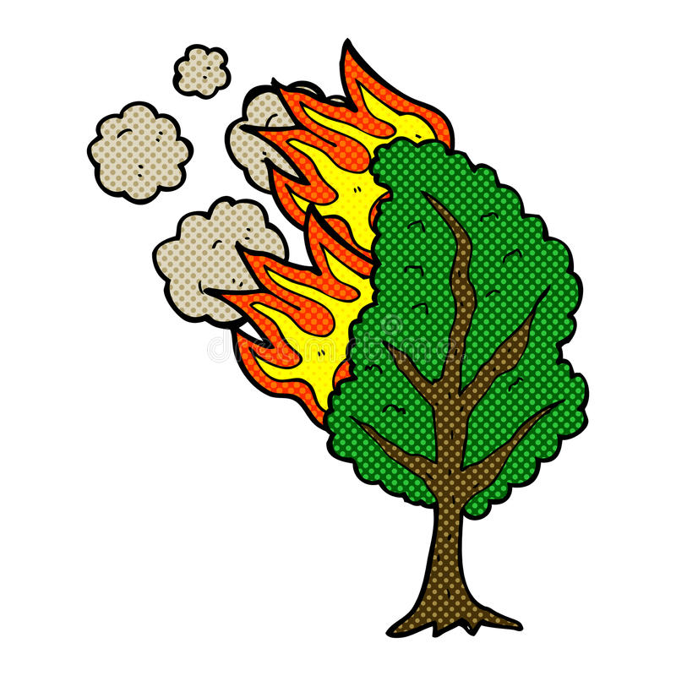
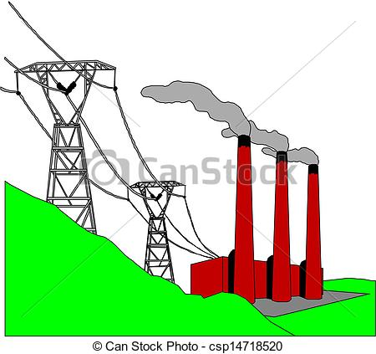
+
-
Add carbon to the atmosphere
Scrub or sink carbon from the atmosphere
Alice Ferguson Foundation

Slide 2
Carbon Cycle Activity
This activity is meant to demonstrate the various ways carbon is released in the atmosphere and ways that it is scrubbed from the atmosphere.
Students should already know:
The Earth is a closed system, and all resources we used come from Earth. All resources we use are part of a natural cycle. When carbon is released into the atmosphere through the burning of fossil fuels, it can prevent heat from escaping our atmosphere and cause the Earth to become warmer.
Carbon is not necessarily a bad thing. Carbon is part of every living thing on Earth. Carbon has a natural cycle, just like water. The Earth has ways of scrubbing or sinking excess carbon in our atmosphere. Carbon only becomes a problem when Earth’s natural cycle can’t keep up with the amount of carbon released into the atmosphere.
This video to explain the carbon cycle quickly: https://www.youtube.com/watch?v=Eq9ReZ7jH4U
Students will learn:
In what ways the Earth scrubs or sinks carbon from the atmosphere. If you eliminate all the human made causes of carbon emissions, the Earth is in balance.
Directions:
As a class, one picture at a time, discuss if this activity, event or process adds carbon or cycles carbon out of the atmosphere. Move the picture to the appropriate column. After all pictures are sorted ask the students which of these pictures are human related? As they identify which ones, move them back to the box. Discuss what is left in the T-chart.
Alice Ferguson Foundation

Slide 3
Agriculture practices can add to carbon emissions if done in an unsustainable way through overgrazing, overcrowding and resources required to raise animals, especially cows.
Transportation through our cities and around our world is all possible through the burning of fossil fuels.
Industry, such as the manufacturing of single use plastics, is very energy and raw material intensive.
Electricity or energy for all our buildings is mostly generated in non-renewable way through the burning of fossil fuels such as coal or oil.
As decomposers break down the remains of once living organisms, the carbon that was once part of that organisms’ body is released.
Healthy forests with dense underbrush and canopies are really good at scrubbing carbon from the air during photosynthesis.
Healthy soil can sink carbon from the atmosphere and store it in the soil carbon pool. This process is primarily mediated by plants through photosynthesis and the living micro organisms in the soil.
Ocean plants, including algae, absorb carbon just like land plants. Wind causes waves and turbulence, which allows the ocean water to absorb the carbon dioxide.
Deforestation not only releases carbon through the process of cutting the trees and decomposition, but we also loose large areas of land that were helping to scrub carbon.
Forest fires release carbon from the break down of the tree itself and the elimination of a carbon scrub. However, forest fires are a natural process that some ecosystems depend on.
Volcanos release carbon into the atmosphere when they erupt.
Alice Ferguson Foundation

Slide 4
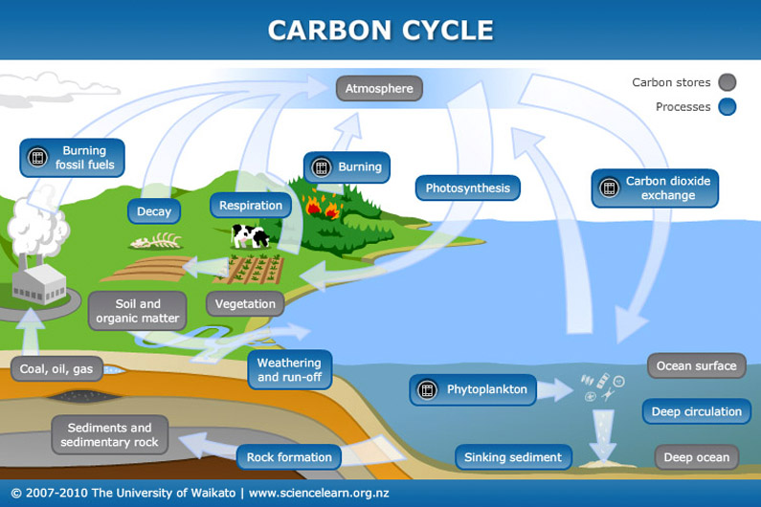
Alice Ferguson Foundation

